Slide 1
PERSONA DEVELOPMENT
DOWNLOADABLE TEMPLATE

Slide 2
PERSONA DEVELOPMENT TEMPLATE
What is a buyer persona?
A buyer persona is a semi-fictional representation of your ideal customer. A persona is constructed using mostly real data uncovered by market research and industry data as well as some educated guesses.
Defining your buyer personas will help you understand your prospective customer’s needs, wants, challenges and many other traits. By uncovering these insights about your ideal buyer you can tailor and personalise your content.
Now more than ever, users expect a high-value and seamless user experience. Your persona research will guide you on how to best deliver this.

Slide 3
PERSONA DEVELOPMENT TEMPLATE
Improve your targeting and personalisation by refining the relevance of your messaging..
The benefits of buyer personas.
1.
2.
Enhance your customer understanding by identifying unique insights about customer needs, wants and challenges.
You can use personas and segments in a variety of different ways depending on what your business wants to achieve. The primary usage is to effectively segment your audience, creating groups of similar prospects. This segmentation will enable you to send the right messages to the right people at the right time.
The insights derived from your persona research can also influence other things such as future product development and help establish gaps within your market too.
3.
Upgrade your team alignment by ensuring everyone in your business has a clear understanding of your target market.
4.
Increase your conversion rates by producing highly targeted campaigns that speak directly to the needs and desires of your customers.
5.
Grow your return on investment by targeting your marketing efforts more effectively and providing a personalised experience.

Slide 4
PERSONA DEVELOPMENT TEMPLATE
How you can use your buyer personas.
Ultimately you want every experience your prospects, leads and customers have with you to be a valuable one. Deliver this successfully and they’ll come back for more.
You can use your persona research to understand and better target the needs, behaviours, and motivations of specific groups of customers. Your personas can be used in marketing, product development, customer service, sales, and content creation to create more targeted, personalised, and effective marketing campaigns.

Slide 5
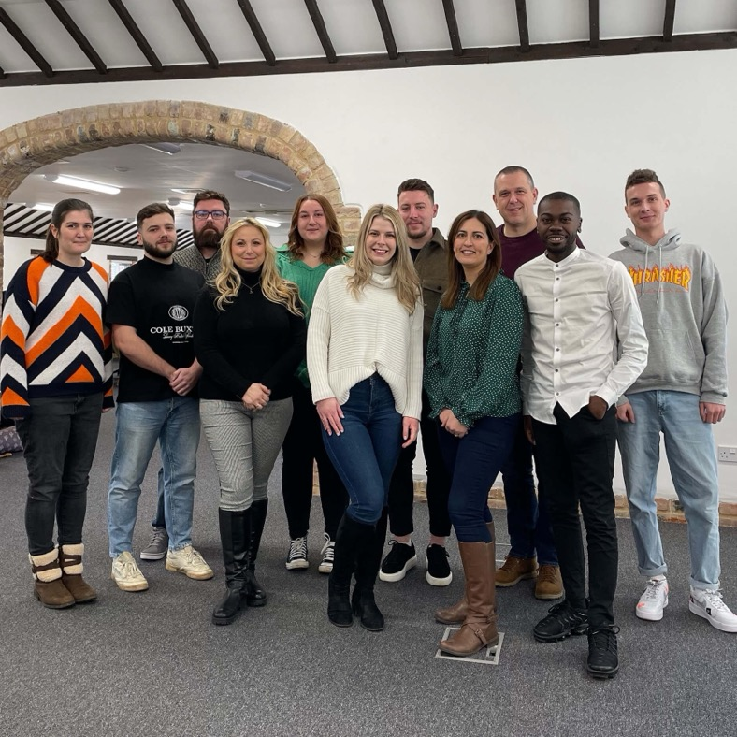
PERSONA DEVELOPMENT TEMPLATE
Persona development at Loop Digital.
We offer persona development as one of our many service offerings.
At Loop Digital, we follow a strict research process that enables us to deliver and analyse the conclusive buyer data you need. Your personas will become the blueprint for targeting your messaging and enhancing your lead nurturing programme. Empowering you to understand your buyers like never before.
Get in touch with one of our experts for more information about how we can support your brand.

Slide 6
PERSONA EXAMPLE
For the purpose of the example, imagine your business is a telecommunications company selling office hardware like phones, computers, printers etc.

Slide 7
PERSONA DEVELOPMENT TEMPLATE
Background Information.
Necessary Information.
Additional Information.
The background information should ultimately provide you with a top-level overview of your target market. You can use primary and secondary data to complete this.
The information outlined below will enable you to put yourself in the perspective of your ideal buyer. You’ll gain a strong understanding of their responsibilities, needs, and challenges as well as identify how your product or service can help them achieve their goals.
Provide more of a background on the potential buyer. This is additional and not necessary if you don’t think it’ll benefit your planning.
Image: (Let’s put a face to the name)
Name: (Try and pick something memorable) Travel Theresa
Basic Demographics: (Age, Gender, Job Title, Location) 29, Female, Holiday Broker, UK, West Midlands
Level of Education: (What’s their highest level of education) Level 3 Extended Diploma
Level of Experience: (How long have they been within the role) 8 Years Experience in Current Role
Industry: (Which industry best describes their line of work) Travel & Tourism Industry
Quote: (Try and use a real customer quote) “The phones at my company are ancient and hinders my productivity”
Responsibilities & Skills: (What is this persona’s speciality, what are their key skills?) Key responsibility is booking customers' holidays and communicating with external transport and insurance providers. Sorting numerous streams of admin ensuring she meets deadlines. Fixing or amending issues that could arise.
Challenges & Goals: (What are this persona’s key challenges and primary/secondary goals?) She struggles with her time management and communication with external teams. She’d like her branch to increase efficiency and cut down wasted time.
Needs: (What will help this persona overcome their challenges and achieve their goals?) The company infrastructure is dated, she needs reliable, modern and easy-to-use hardware to increase the branch’s day-to-day efficiency.
Frustrations: (What frustrates this persona?) Over-technical setups, waiting times, disorganisation.
Key Knowledge Sources: (Where does this persona go to find information? A particular blog or network that they ask?) Uses search engines for most of queries but will likely approach her network online and offline for recommendations.
What can we do? (What can you provide or do to help this person achieve their goals?) Provide reliable/easy-to-use tech to the branch that will reduce waiting times and increase automation resulting in vastly improved productivity.
Preferred Touchpoints: (How does this persona prefer to be communicated?) Most commonly phone calls and email, will occasionally speak to people within her network online on channels like LinkedIn.
Common Objections: (Why wouldn’t they purchase your product or service?) She doesn’t have a huge budget to spend on newer equipment for the branch, will likely require buy-in from key stakeholders.
Favourite Brands: (Which brands does this persona commonly interact with or purchase from?) River Island, ITV, MAC Cosmetics, Boots
Hobbies: (What does this persona do in their spare time?) Socialising Playing Tennis
Expendable Income: (How much expendable income does this persona have?) £900 per month expendable income
Short Bio: (Give your persona a story) Theresa, 29 is a Holiday Broker in Birmingham, she has 1 child and enjoys spending time with daughter or playing a game of tennis after work.

Slide 8
PERSONA DEVELOPMENT TEMPLATE
How many personas do I need to create?
That’s entirely down to you and your business. You can have as many or as few personas as you see fit, we’d always recommend starting small and building up, persona development is an ongoing process.
Frequently asked questions.
How do I find the information I need?
Finding this information will require market research, using both primary and secondary research methods to fill in the blanks. A few options you could look into are customer interviews and surveys or add form fields onto your website that capture the information you need.
Before you jump into your persona development process, we’ve compiled some of our most frequently asked questions.
Who should create the personas?
Usually, persona development would sit within your marketing department however, the more information you can gather the more accurate your personas will be. Consider arranging a cross-department meeting to discuss this.
?
How often should I review my personas?
We’d suggest reviewing your personas every 6 months and checking that everything still looks right and reflects where the business is at the time.

Slide 9
PERSONA TEMPLATES
Now it’s your turn, we’ve included 4 blank templates, if you need more, you can copy and paste additionall slides.

Slide 10
PERSONA DEVELOPMENT TEMPLATE
Background Information.
Necessary Information.
Additional Information.
Image:
Name:
Basic Demographics:
Level of Education:
Level of Experience:
Industry:
Quote:
Responsibilities & Skills:
Challenges & Goals:
Needs:
Frustrations:
Key Knowledge Sources:
What can we do?
Preferred Touchpoints:
Common Objections:
Favourite Brands:
Hobbies:
Expendable Income:
Short Bio:

Slide 11
PERSONA DEVELOPMENT TEMPLATE
Background Information.
Necessary Information.
Additional Information.
Image:
Name:
Basic Demographics:
Level of Education:
Level of Experience:
Industry:
Quote:
Responsibilities & Skills:
Challenges & Goals:
Needs:
Frustrations:
Key Knowledge Sources:
What can we do?
Preferred Touchpoints:
Common Objections:
Favourite Brands:
Hobbies:
Expendable Income:
Short Bio:

Slide 12
PERSONA DEVELOPMENT TEMPLATE
Background Information.
Necessary Information.
Additional Information.
Image:
Name:
Basic Demographics:
Level of Education:
Level of Experience:
Industry:
Quote:
Responsibilities & Skills:
Challenges & Goals:
Needs:
Frustrations:
Key Knowledge Sources:
What can we do?
Preferred Touchpoints:
Common Objections:
Favourite Brands:
Hobbies:
Expendable Income:
Short Bio:

Slide 13
PERSONA DEVELOPMENT TEMPLATE
Background Information.
Necessary Information.
Additional Information.
Image:
Name:
Basic Demographics:
Level of Education:
Level of Experience:
Industry:
Quote:
Responsibilities & Skills:
Challenges & Goals:
Needs:
Frustrations:
Key Knowledge Sources:
What can we do?
Preferred Touchpoints:
Common Objections:
Favourite Brands:
Hobbies:
Expendable Income:
Short Bio:

Slide 14
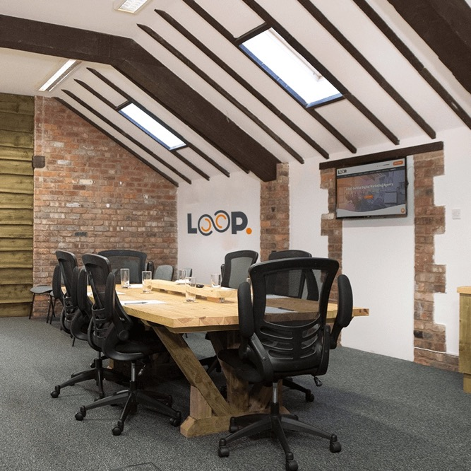
Still need a hand?
If you like what you see and want to learn more about how we can generate sustainable growth for your business.
01604 806020 / 07725 227341
michael@loop-digital.co.uk
www.loop-digital.co.uk
BOOK A MEETING
Blisworth Hill Farm, Northamptonshire, NN7 3DB
Notes:
Move small title to set corner
Increase line spacing between titles and subtext

